Slide 1
Physics 111: Mechanics Lecture 5
Dahiru Sanni

Slide 2
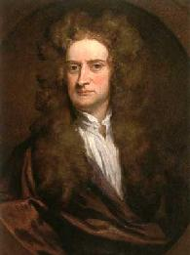
Applications of Newton’s Laws
Newton’s first law
Newton’s second law
Newton’s third law
Frictional forces
Applications of
Newton’s laws
Circular Motion
Isaac Newton’s work represents one of the greatest contributions to science ever made by an individual.

Slide 3
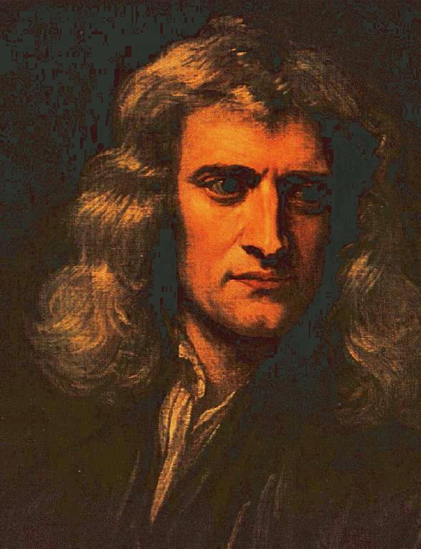
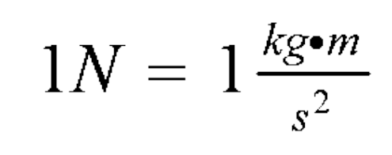
Newton’s Laws
Force is a vector
Unit of force in S.I.:
If no net force acts on a body, then the body’s velocity cannot change.
The net force on a body is equal to the product of the body’s mass and acceleration.
When two bodies interact, the force on the bodies from each other are always equal in magnitude and opposite in direction.

Slide 4

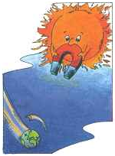
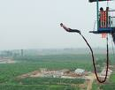
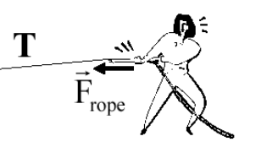
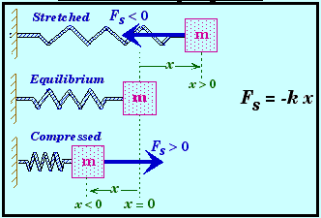
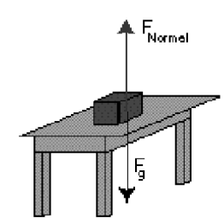
Forces
The measure of interaction between two objects
Vector quantity: has magnitude and direction
May be a contact force or a field force
Particular forces:
  Gravitational Force
  Friction Force
  Tension Force
  Normal Force
  Spring Force

Slide 5
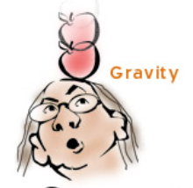
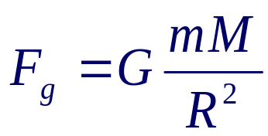
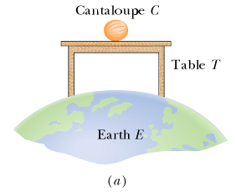
Gravitational Force: mg
Gravitational force is a vector
The magnitude of the gravitational force acting on an object of mass m near the Earth’s surface is called the weight w of the object
w = mg
Direction: vertically downward
m: Mass
g = 9.8 m/s²

Slide 6
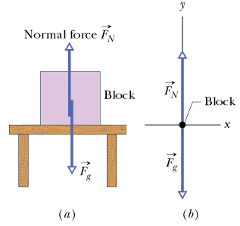

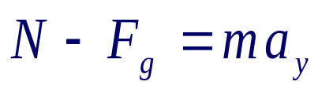
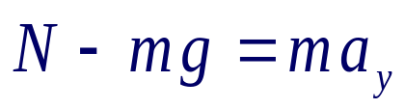

Normal Force: N
Force from a solid surface which keeps object from falling through
Direction: always perpendicular to the surface
Magnitude: not necessary to be mg

Slide 7
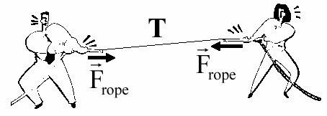

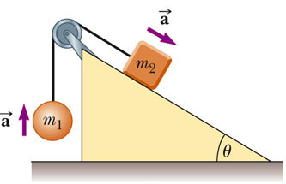
Tension Force: T
A taut rope exerts forces on whatever holds its ends
Direction: always along the cord (rope, cable, string ……) and away from the object
Magnitude: depend on situation
T1
T1 = T = T2
T2

Slide 8
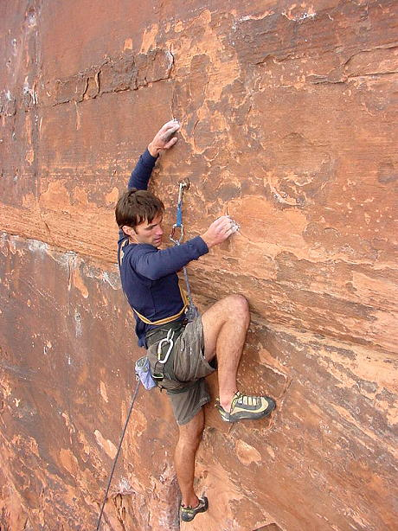
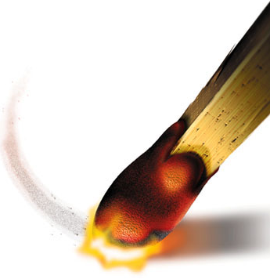
Forces of Friction: f
When an object is in motion on a surface or through a viscous medium, there will be a resistance to the motion. This resistance is called the force of friction
This is due to the interactions between the object and its environment
We will be concerned with two types of frictional force
  Force of static friction: f_{s}
  Force of kinetic friction: f_{k}
Direction: opposite the direction of the intended motion
  If moving: in direction opposite the velocity
  If stationary, in direction of the vector sum of other forces

Slide 9
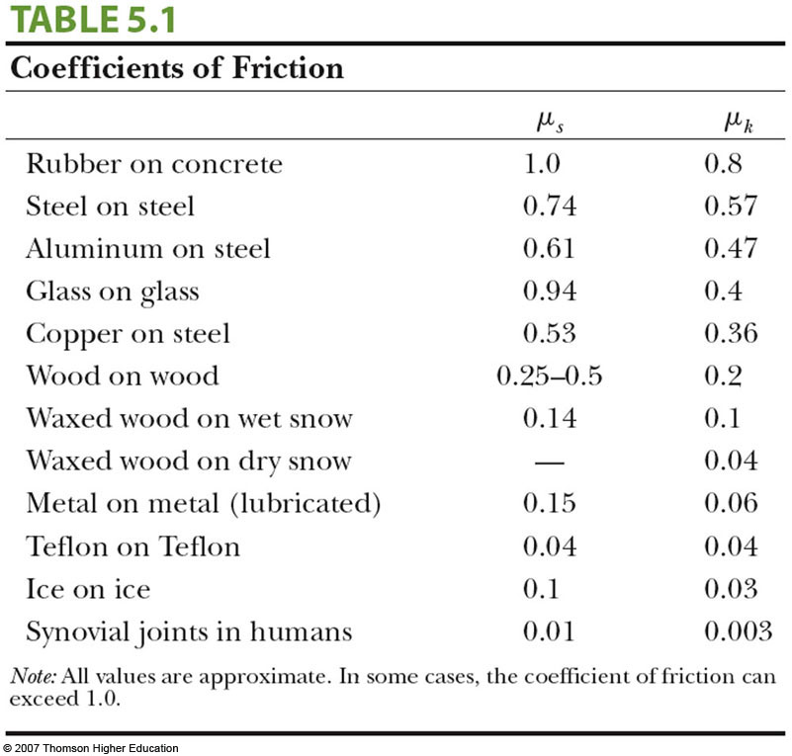
Forces of Friction: Magnitude
Magnitude: Friction is proportional to the normal force
  Static friction: F_{f} = F ≤ μ_{s}N
  Kinetic friction: F_{f} = μ_{k}N
  μ is the coefficient of friction
The coefficients of friction are nearly independent of the area of contact (why?)

Slide 10
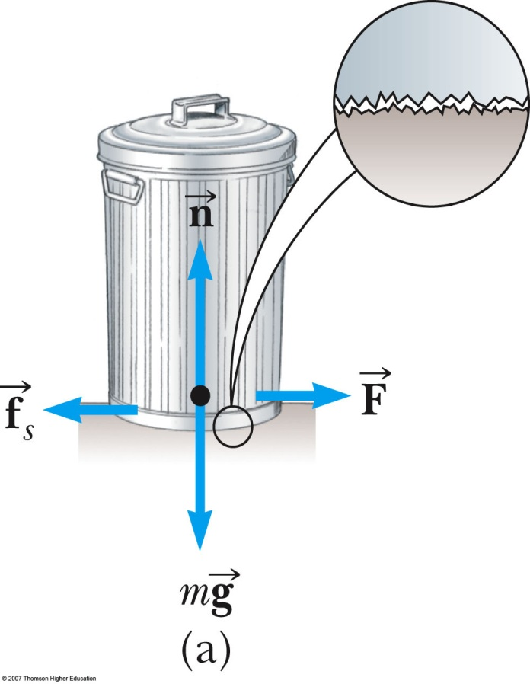


Static Friction
Static friction acts to keep the object from moving
If increases, so does
If decreases, so does
ƒ_{s} ≤ µ_{s} N
  Remember, the equality holds when the surfaces are on the verge of slipping

Slide 11
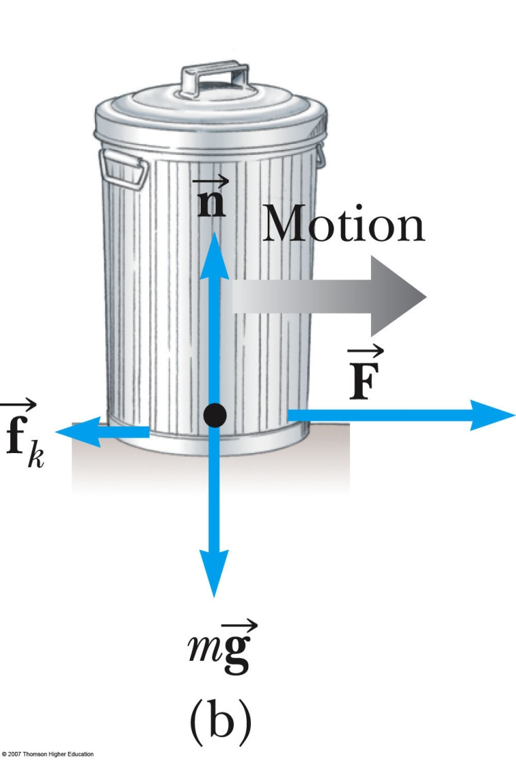
Kinetic Friction
The force of kinetic friction acts when the object is in motion
Although µ_{k} can vary with speed, we shall neglect any such variations
ƒ_{k} = µ_{k} N

Slide 12
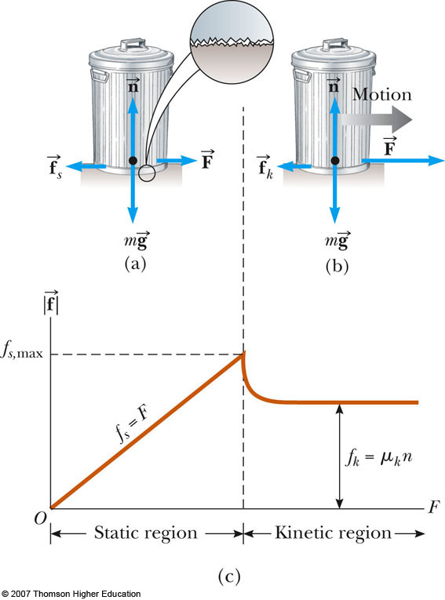
Explore Forces of Friction
Vary the applied force
Note the value of the frictional force
  Compare the values
Note what happens when the can starts to move

Slide 13
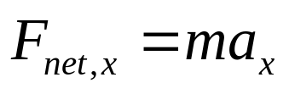
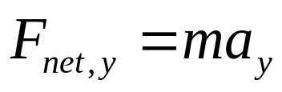
Hints for Problem-Solving
Read the problem carefully at least once
Draw a picture of the system, identify the object of primary interest, and indicate forces with arrows
Label each force in the picture in a way that will bring to mind what physical quantity the label stands for (e.g., T for tension)
Draw a free-body diagram of the object of interest, based on the labeled picture. If additional objects are involved, draw separate free-body diagram for them
Choose a convenient coordinate system for each object
Apply Newton’s second law. The x- and y-components of Newton second law should be taken from the vector equation and written individually. This often results in two equations and two unknowns
Solve for the desired unknown quantity, and substitute the numbers

Slide 14

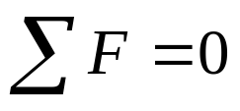
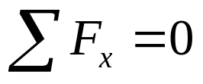
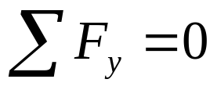
Objects in Equilibrium
Objects that are either at rest or moving with constant velocity are said to be in equilibrium
Acceleration of an object can be modeled as zero:
Mathematically, the net force acting on the object is zero
Equivalent to the set of component equations given by

Slide 15
Equilibrium, Example 1
What is the smallest value of the force F such that the 2.0-kg block will not slide down the wall? The coefficient of static friction between the block and the wall is 0.2. ?
f
N
F
F
mg

Slide 16
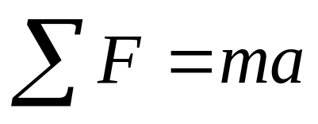
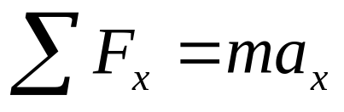
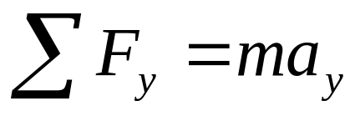
Accelerating Objects
If an object that can be modeled as a particle experiences an acceleration, there must be a nonzero net force acting on it
Draw a free-body diagram
Apply Newton’s Second Law in component form

Slide 17
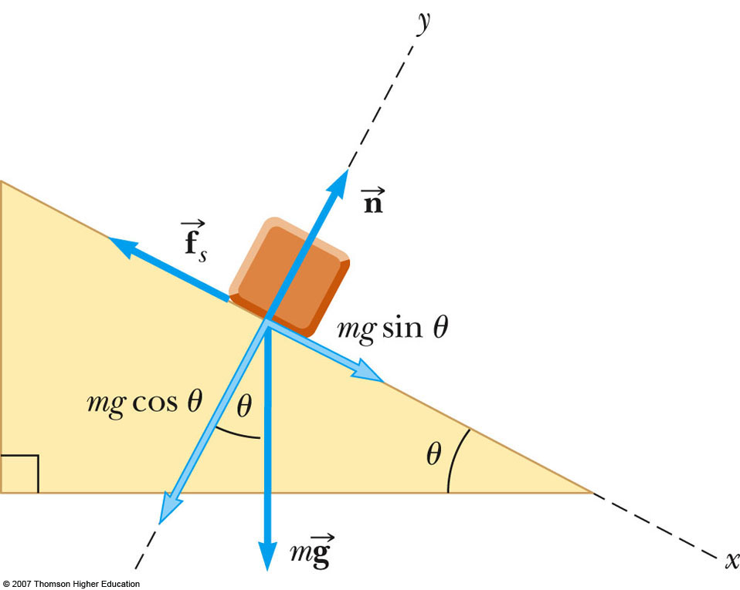
Inclined Plane
Suppose a block with a mass of 2.50 kg is resting on a ramp. If the coefficient of static friction between the block and ramp is 0.350, what maximum angle can the ramp make with the horizontal before the block starts to slip down?

Slide 18
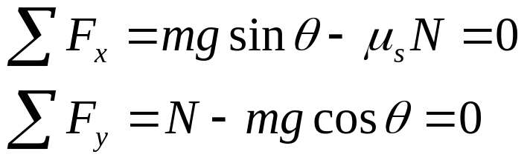

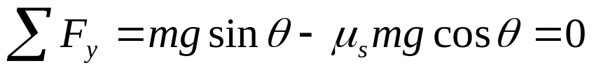
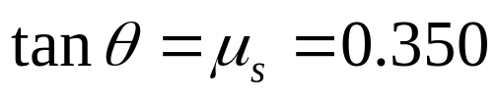
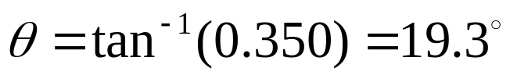
Inclined Plane
Newton 2nd law:
Then
So

Slide 19
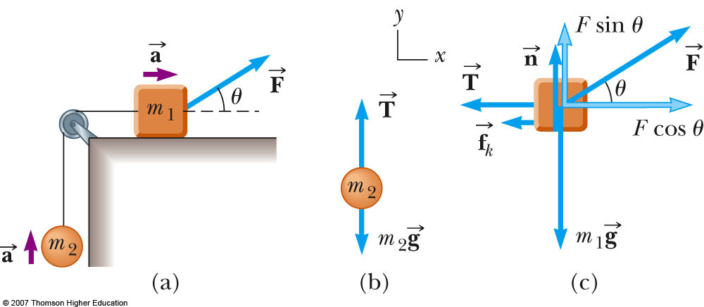
Multiple Objects
A block of mass m1 on a rough, horizontal surface is connected to a ball of mass m2 by a lightweight cord over a lightweight, frictionless pulley as shown in figure. A force of magnitude F at an angle θ with the horizontal is applied to the block as shown and the block slides to the right. The coefficient of kinetic friction between the block and surface is μ_{k}. Find the magnitude of acceleration of the two objects.

Slide 20
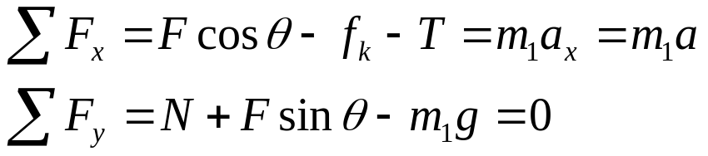





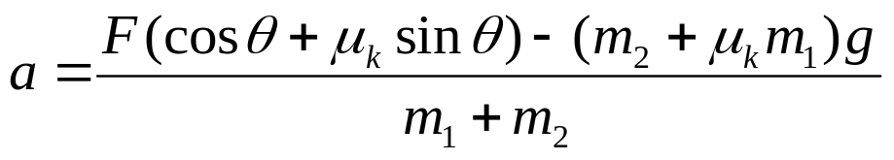
Multiple Objects
m₁:
m₂:

Slide 22
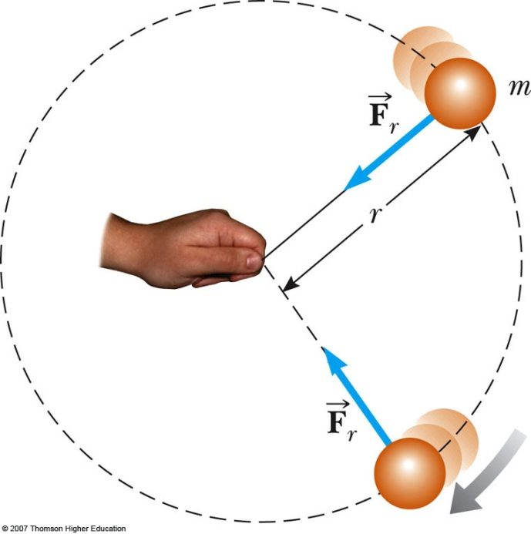
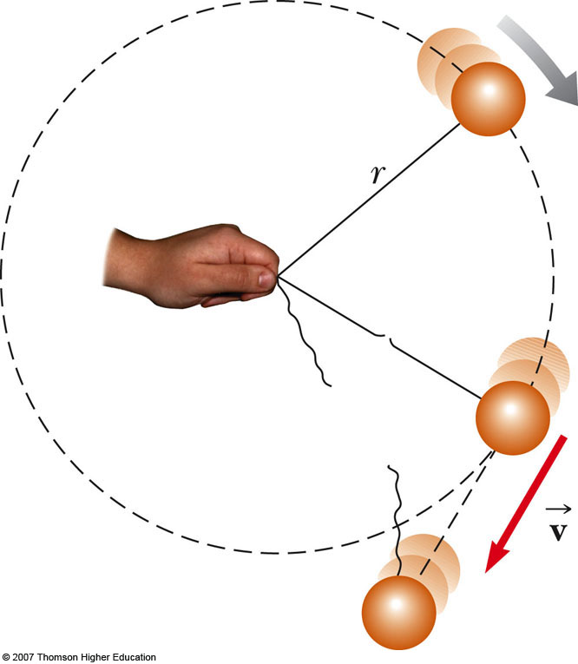
Uniform Circular Motion: Definition
Uniform circular motion
Constant speed, or,
constant magnitude of velocity
Motion along a circle:
Changing direction of velocity

Slide 23
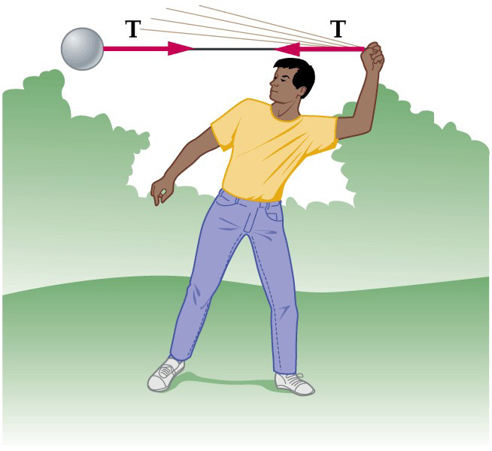

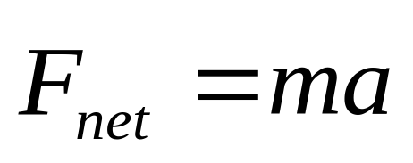
Uniform Circular Motion: Observations
Object moving along a curved path with constant speed
  Magnitude of velocity: same
  Direction of velocity: changing
  Velocity : changing
  Acceleration is NOT zero!
  Net force acting on an object is NOT zero
  “Centripetal force”

Slide 24
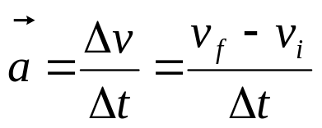

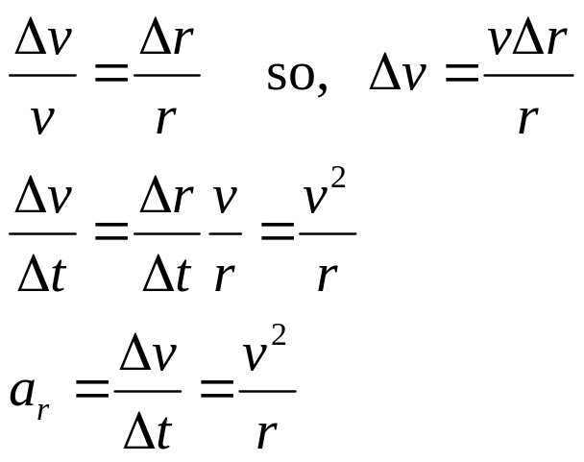
Uniform Circular Motion
Magnitude:
Direction: Centripetal
v_{i}
Δv = v_{f} - v_{i}
v_{f}
v_{i}
y
A
B
v_{f}
Δr
R
r_{i}
r_{f}
O
x

Slide 25
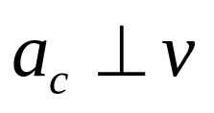
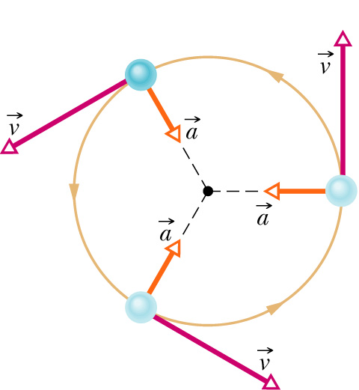
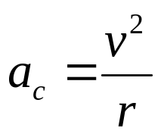
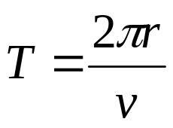
Uniform Circular Motion
Velocity:
  Magnitude: constant v
  The direction of the velocity is tangent to the circle
Acceleration:
  Magnitude:
  directed toward the center of the circle of motion
Period:
  time interval required for one complete revolution of the particle

Slide 26
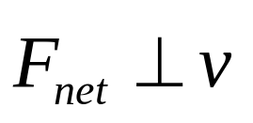
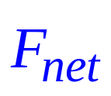



Centripetal Force
Acceleration:
  Magnitude:
  Direction: toward the center of the circle of motion
Force:
  Start from Newton’s 2nd Law
  Magnitude:
  Direction: toward the center of the circle of motion

Slide 27

What provides Centripetal Force ?
Centripetal force is not a new kind of force
Centripetal force refers to any force that keeps an object following a circular path
Centripetal force is a combination of
  Gravitational force mg: downward to the ground
  Normal force N: perpendicular to the surface
  Tension force T: along the cord and away from object
  Static friction force: f_{s}^{max} = µ_{s}N

Slide 28



What provides Centripetal Force ?
N
a
v
mg

Slide 29
Problem Solving Strategy
Draw a free body diagram, showing and labeling all the forces acting on the object(s)
Choose a coordinate system that has one axis perpendicular to the circular path and the other axis tangent to the circular path
Find the net force toward the center of the circular path (this is the force that causes the centripetal acceleration, F_{C})
Use Newton’s second law
  The directions will be radial, normal, and tangential
  The acceleration in the radial direction will be the centripetal acceleration
Solve for the unknown(s)

Slide 30

The Conical Pendulum
A small ball of mass m = 5 kg is suspended from a string of length L = 5 m. The ball revolves with constant speed v in a horizontal circle of radius r = 2 m. Find an expression for v and a.
T
θ
mg

Slide 31


The Conical Pendulum
Find v and a

Slide 32


Level Curves
A 1500 kg car moving on a flat, horizontal road negotiates a curve as shown. If the radius of the curve is 35.0 m and the coefficient of static friction between the tires and dry pavement is 0.523, find the maximum speed the car can have and still make the turn successfully.

Slide 33


Level Curves
The force of static friction directed toward the center of the curve keeps the car moving in a circular path.

Slide 34


Banked Curves
A car moving at the designated speed can negotiate the curve. Such a ramp is usually banked, which means that the roadway is tilted toward the inside of the curve. Suppose the designated speed for the ramp is to be 13.4 m/s and the radius of the curve is 35.0 m. At what angle should the curve be banked?

Slide 35

Banked Curves

